Slide 1
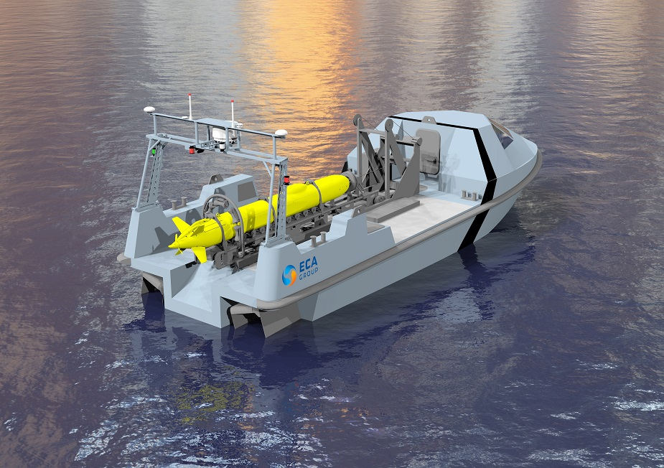
Progress Report USV Control System
Image from Naval Recognition
Notes:
Morning and welcome to my final presentation, I will begin with a background and motivation of my project. Followed by a description of my system, the testing and results and finally look at some issues that came up in the project and the solutions to these issues.

Slide 2
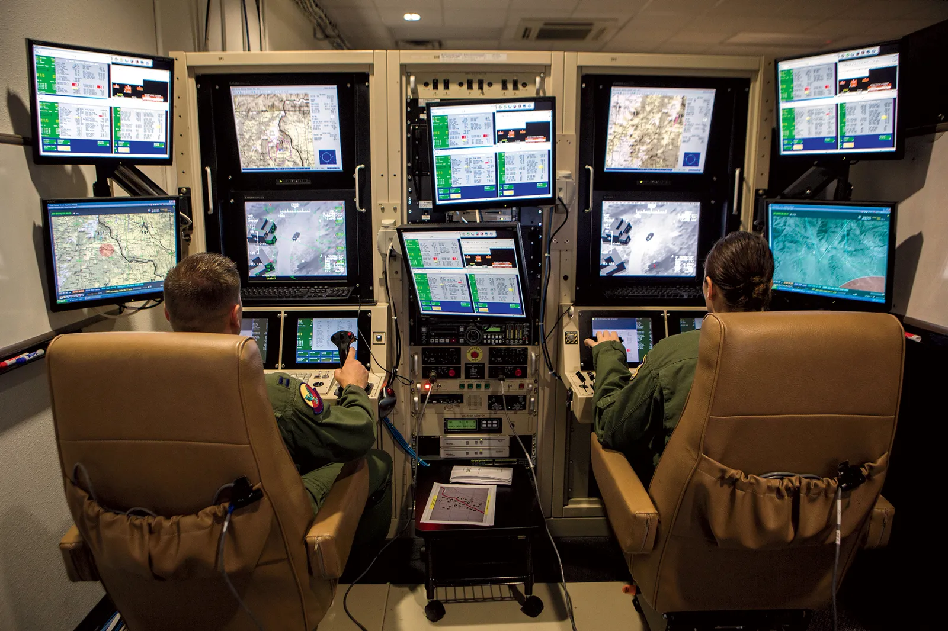
Background
USV
Unmanned Surface Vessel.
Independent Control.
Autonomous Steering.
Obstacle Avoidance.
Active Positioning Knowledge.
Off-site Control.
Open Communication Connection.
Image from GQ
Notes:
To start with, the scope of this project is to design and implement a control system for an electric USV. A USV stands for an unmanned surface vessel. A USV can either be fully independent and make use of automated steering and possibly obstacle avoidance. For independent control, the USV needs to have an active knowledge of its current position using a combination of GPS data and digital Compass. Or a USV can be controlled from an off-site location and will therefore only need to have an open communication connection between the USV and the site from where it is being controlled. In this project I will be focusing of creating an independent control USV with the focus being on the design and implementation of the control system.

Slide 3
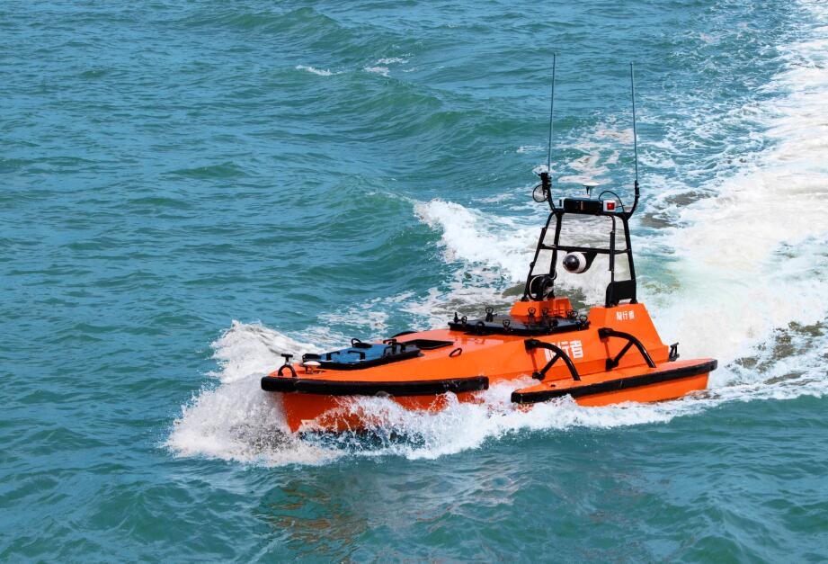
Background
Motivation
Military.
Patrolling.
Fire Support.
Research.
Marine Surveying.
Rescue.
Remote Response Time.
Image from OceanAlpha
Notes:
USVs are incredibly useful and could save a lot of money as they would be cheaper to operate and have a lower carbon footprint than conventional manned vessels. The uses of USVs ranges from the military where they can be used similarly to UAVs for either patrolling or fire support. USVs would also have great uses in the world of marine and nature surveying. These USVs can be fitted with monitoring equipment and together with a data link and solar panels would be able to be constantly recording and transmitting data back to research facilities without having to come in for resupplies. Its only need to come in would be for scheduled or unscheduled maintenance and repairs. Finally, USVs can even be used as part of naval rescue by either having them patrolling remote areas and therefore reducing the response time to distress calls or being able to be sent into situations that might otherwise be deemed too dangerous for manned vessels.

Slide 4
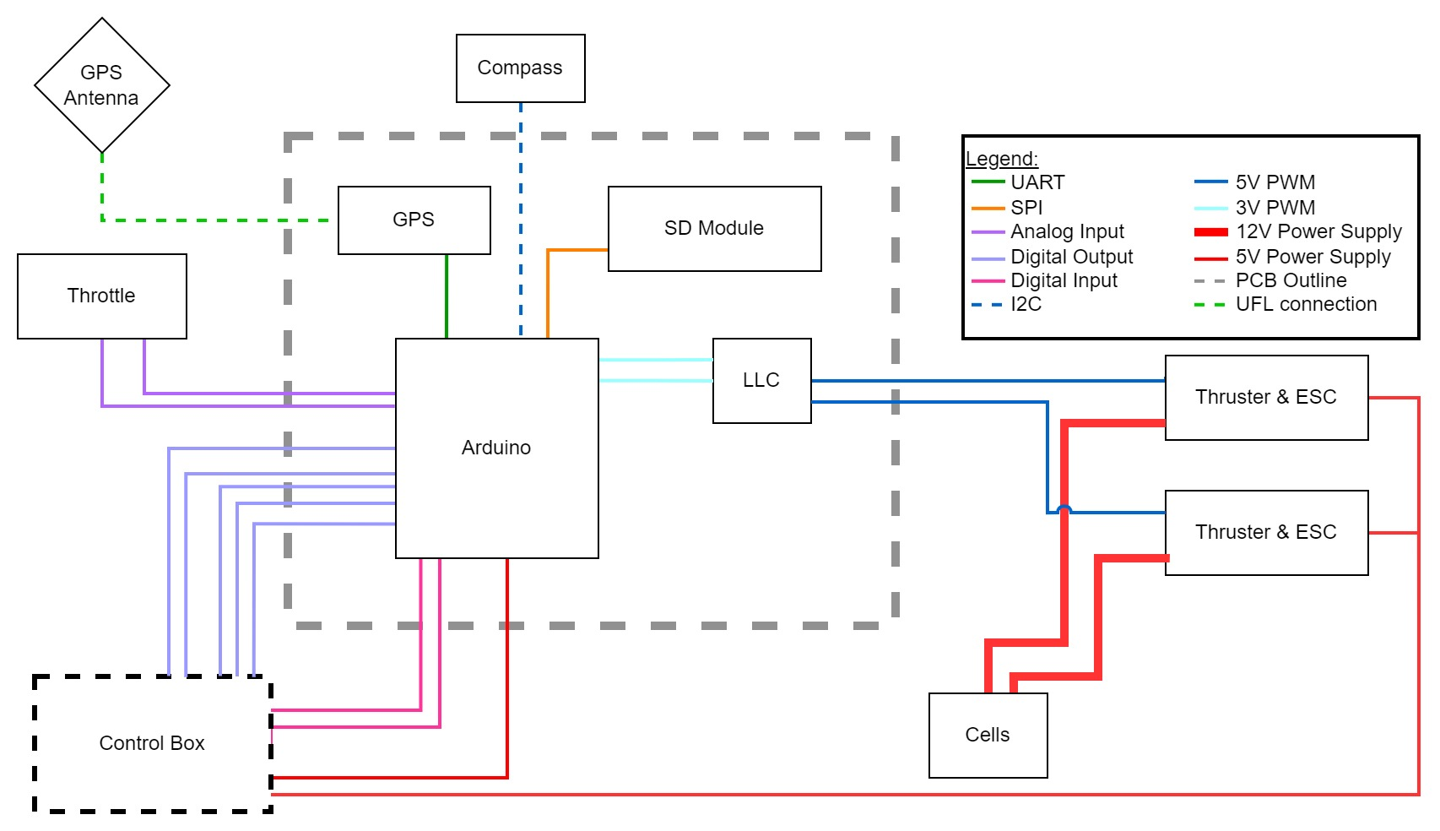
System Schematic
Notes:
This is the system schematic. Inside the grey dashed area is the PCB, on which is the Arduino microcontroller, the GPS module and the Logic level converter to switch up the PWM signal from the arduinos 3V to the ESC required 5V. Outside of the grey area is the throttle system, the two thrusters which are complete units with their ESC and the Battery cells. The throttle is made up of two linear pots operating between 0 and 3V. Their signal is parsed to the Arduino ADC. The Arduino outputs two 3V PWM signals which are stepped up by the LLC and then parsed on to the thrusters. The high current draw is directly to the thrusters. The gps module operates on 3V and transmits data to the Arduino using UART.

Slide 5
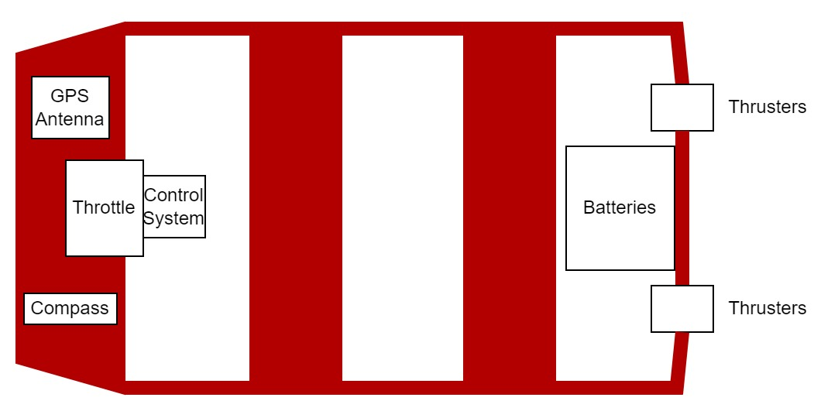
Physical System
System Description
Spider 3 Boat.
POT Throttle System
TD20 Thrusters & ESC.
2 12V Lead-Acid Batteries.
Arduino DUE Microcontroller.
GPS Module.
Digital Compass.
Photo by Luke Kingwill
Notes:
Here is the physical system. It consists of the Spider 3 boat, the two TD20 thrusters and their ESC, a 24V battery system, the Arduino microcontroller, GPS module and the throttle system. The thrusters are mounted onto the back of the boat and the battery cells are position in the well at the back so that the cables which are carrying the high current are as short as possible. The throttle will be mounted on the front bench for ease of use and the PCB will be mounted in close proximity so that the GPS module is as far from the magnetic fields of the motors and high current cables as possible.

Slide 6
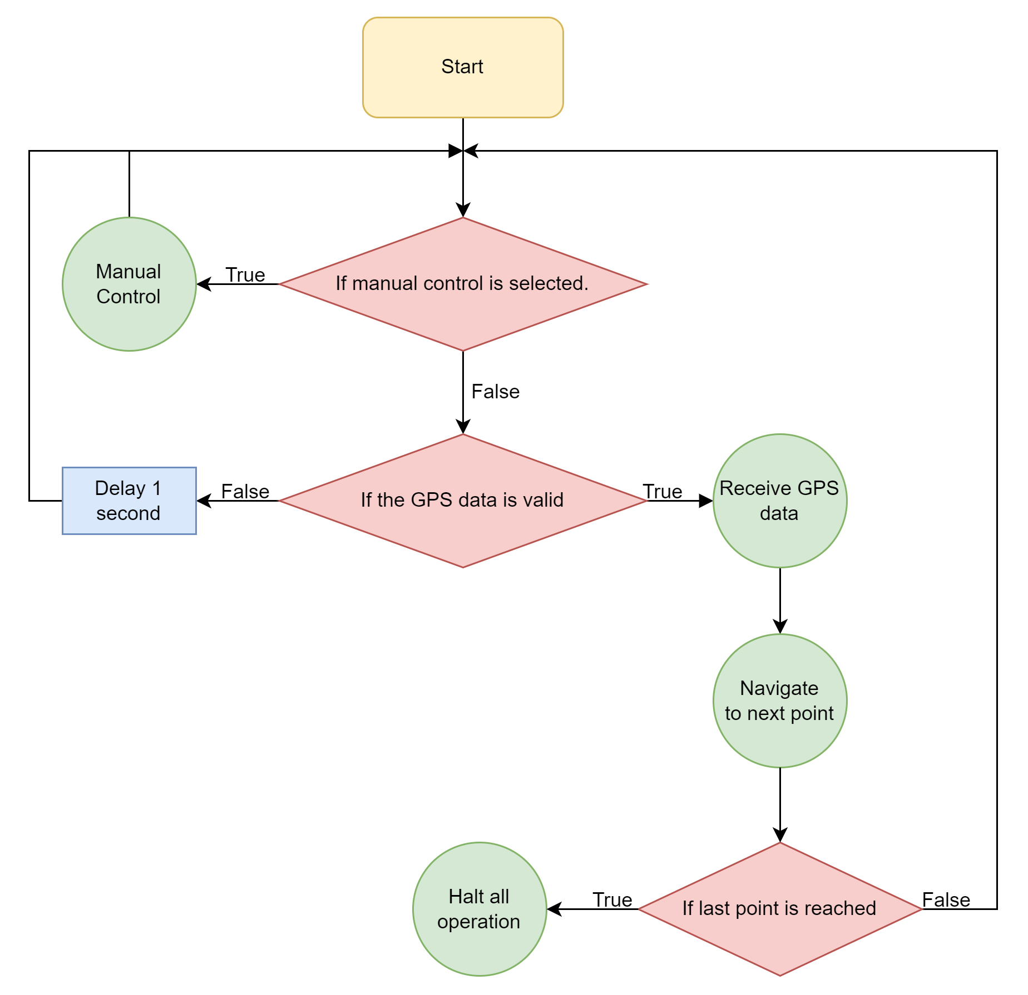
Control System Logic
System States
Three Operating States.
Manual Navigation.
Autonomous Navigation.
Idle State.
Photo by Luke Kingwill
Notes:
The system has three operating states: manual navigation whereby the throttle is used to receive user input and control the thruster. Autonomous navigation whereby the vessel will self navigate to the GPS locations preloaded into the system and the Idle state where the vessel stops all operation once it has completed its navigation route.

Slide 7
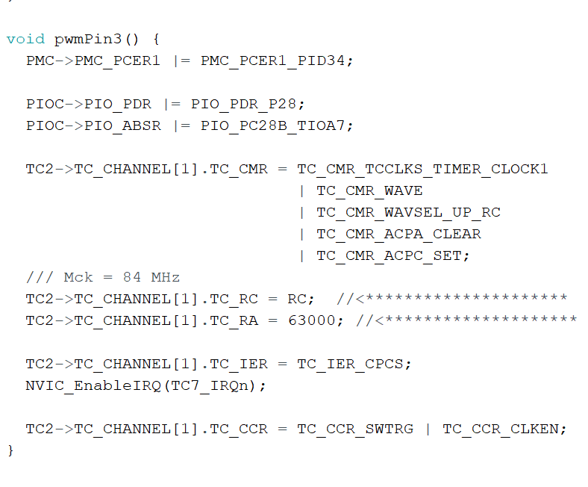
Control System Logic
Manual Control
Analog Read.
Adjust Timer Frequency.
Adjust Timer Duty Cycle.
Update PWM Output.
Receive GPS Data.

Slide 8
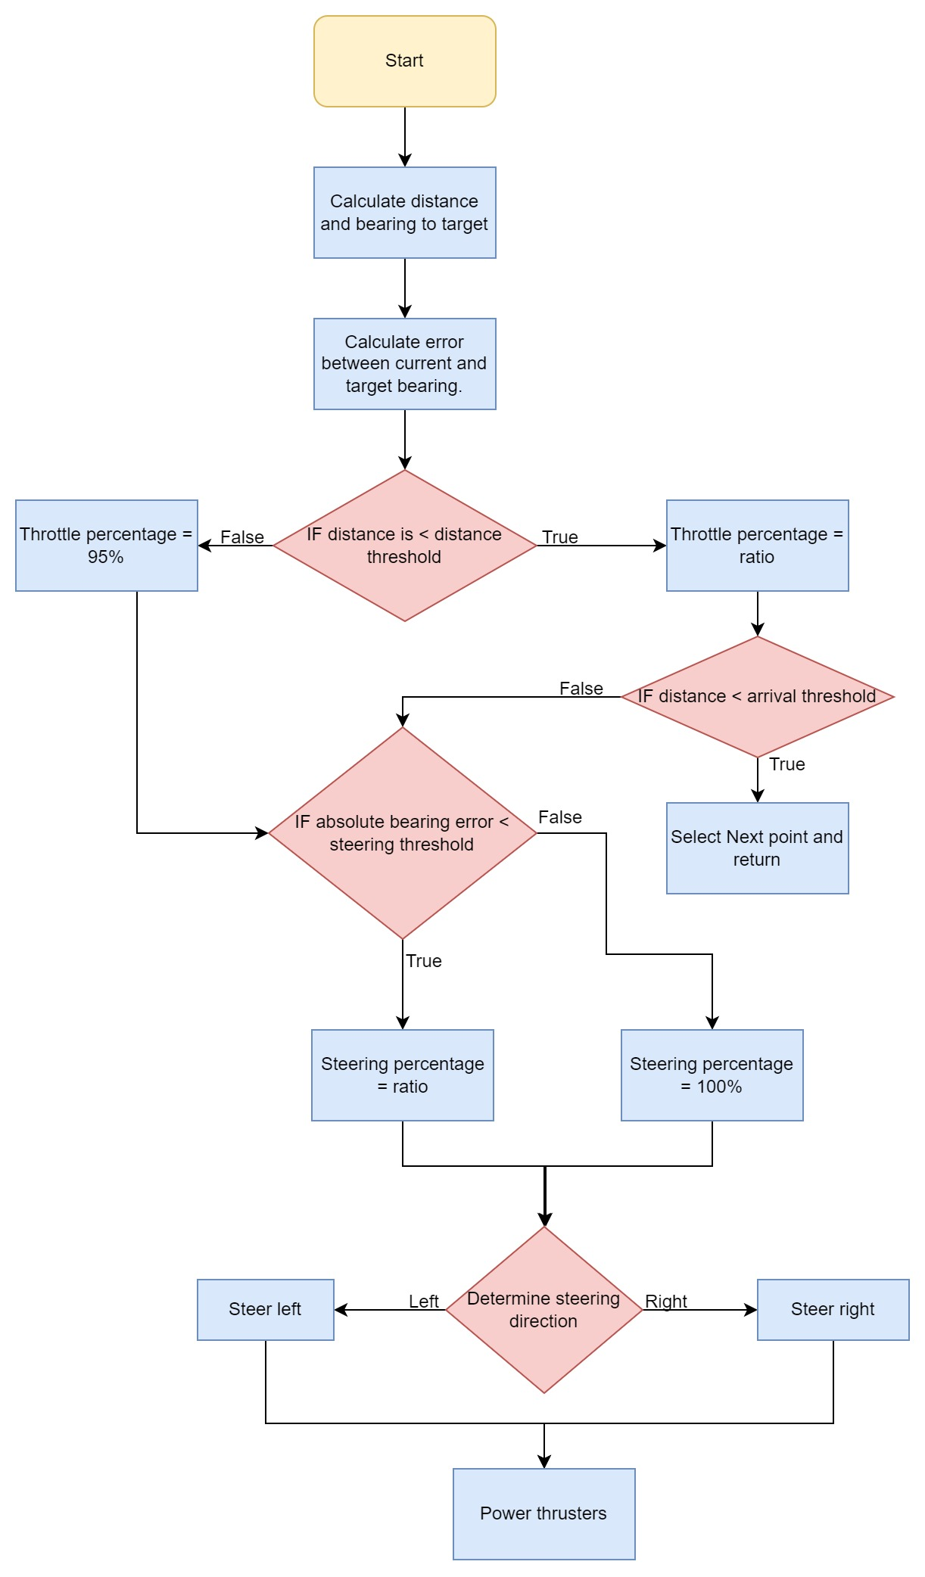
Control System Logic
Autonomous Control
Calculate Distance and Bearing.
Calculate Error.
Apply Proportional Throttle.
Apply Proportional Steering.
Determine Steering Direction.
Update PWM Signals.
Photo by Rob Pike

Slide 9
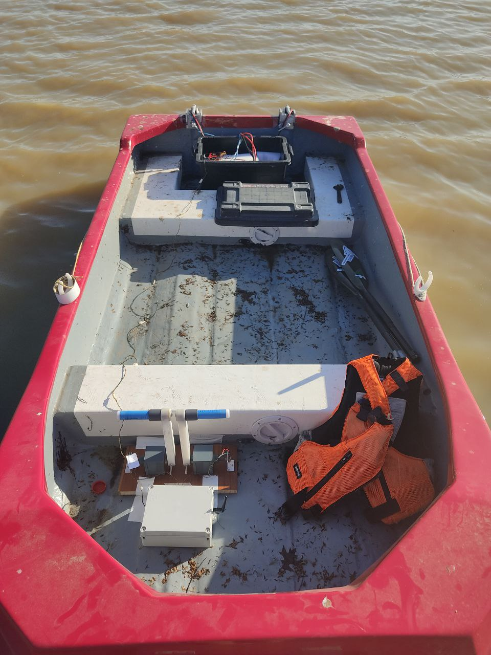
Testing
Safety & Setup
Safety Checklist (Table 4.1)
Vessel is Always Manned.
Electrical Connections Waterproofed.
Setup Checklist (Table 4.2)
Photo by Luke Kingwill

Slide 10
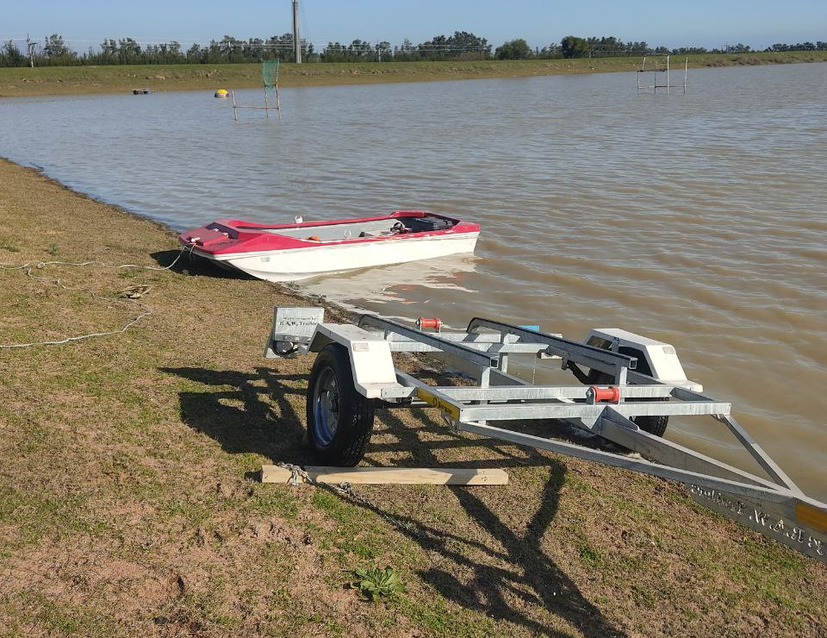
Results
Sub-System
GPS and Compass.
PWM Output.
Throttle Input.
Thruster Control.
Photo by Luke Kingwill

Slide 11
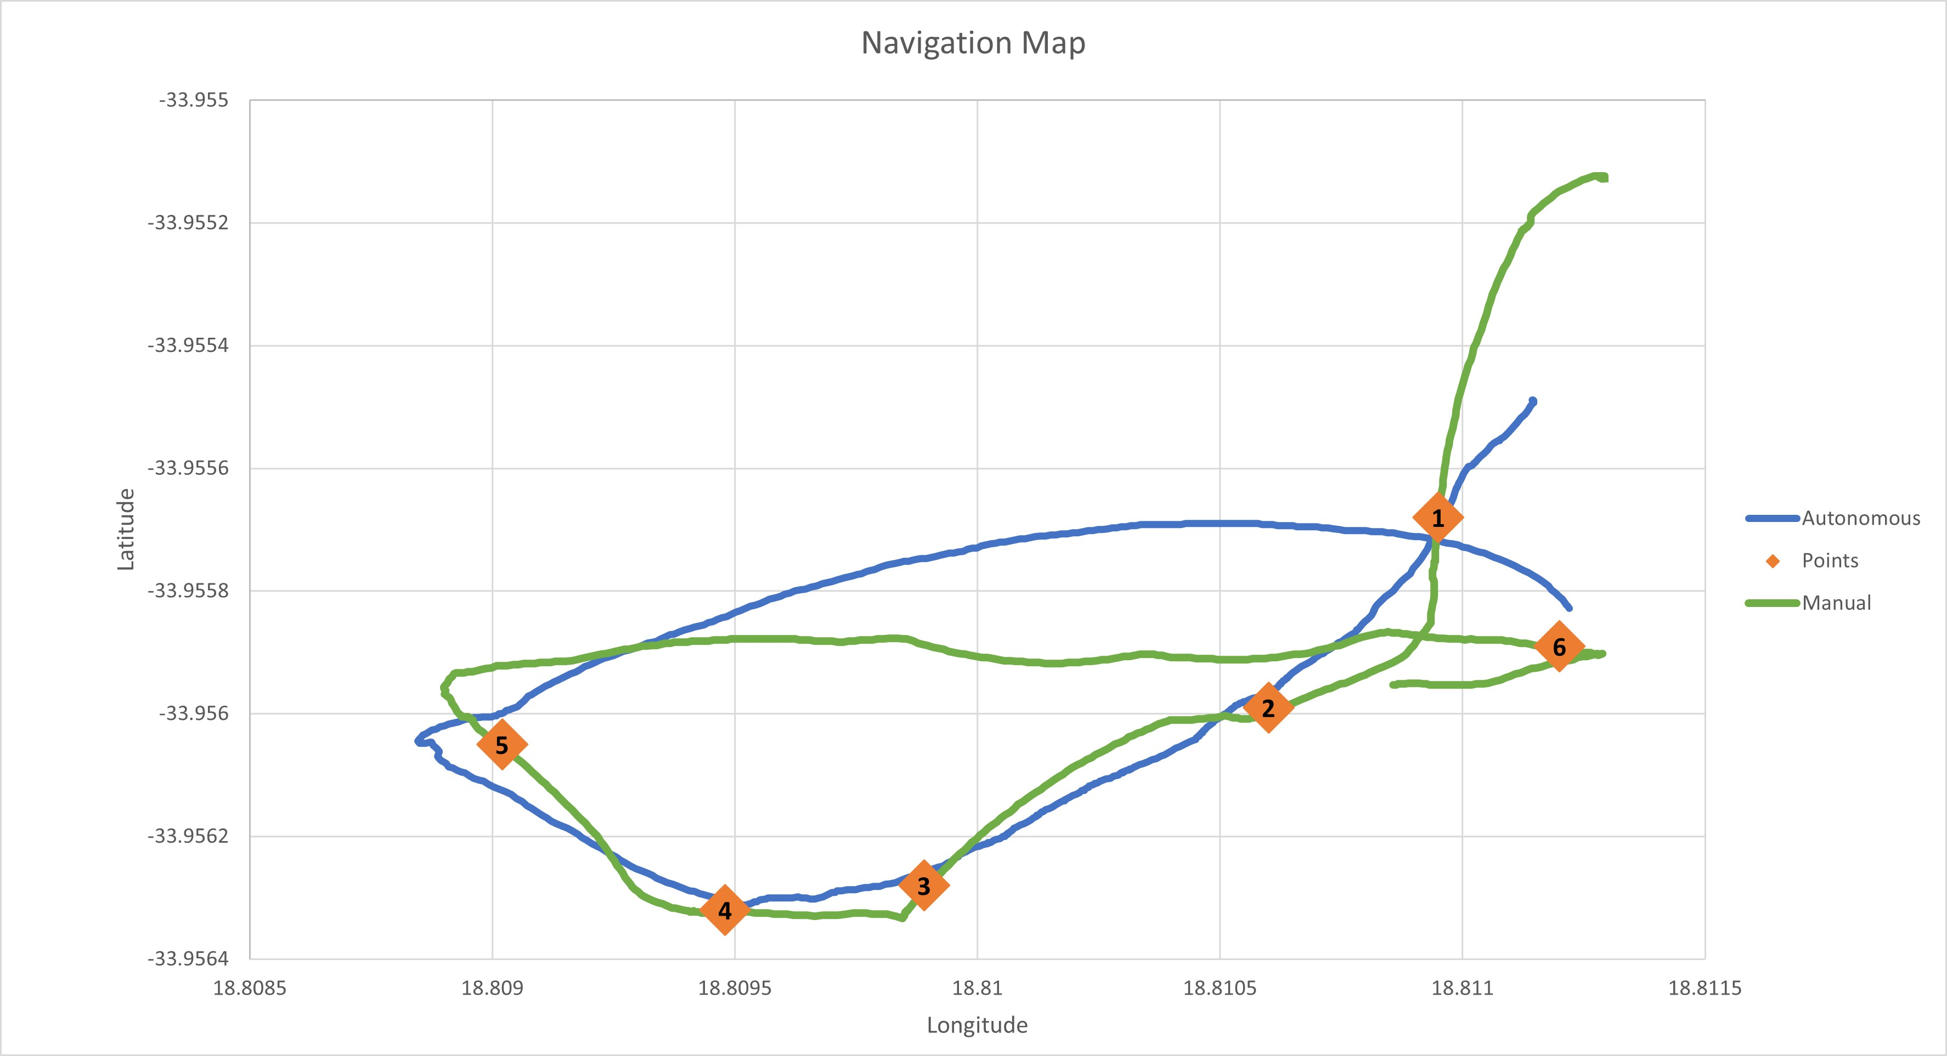
Results
Full System
All Passed.
Windy Conditions.
System Performed Well.

Slide 12
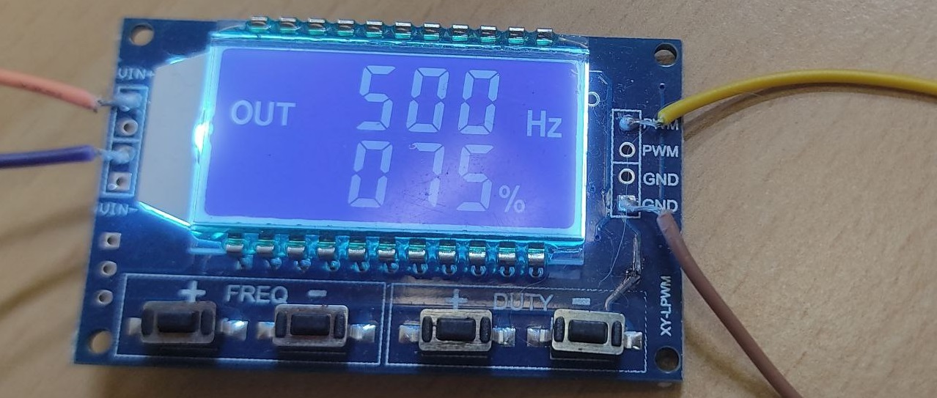
Problems and Solutions
Issues that Arose
Under Powered.
Throttle Control.
Compass Calibration.
Thruster Imperfections.
Photo by Luke Kingwill

Slide 13
Conclusion
The System Performed Well.
Improvements:
Larger Power Supply.
Improved Thrusters.
Further Developments:
Obstacle Avoidance.
Return to Home Functionality.
Power Regeneration:
Solar Panels.

Slide 14
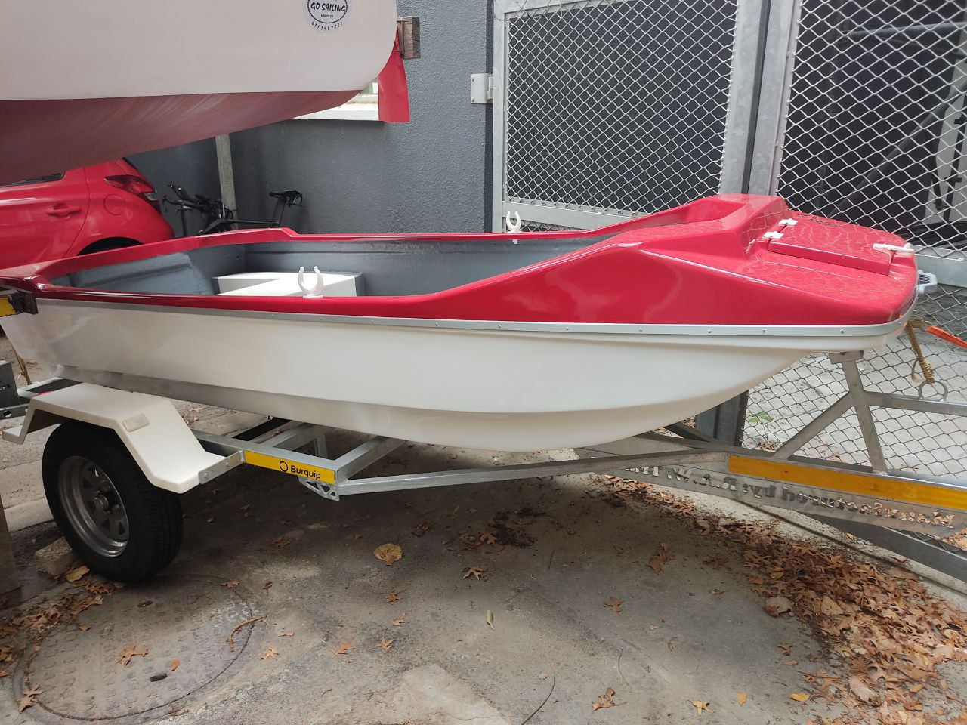
Thank you
Enkosi
Dankie
Photo by Luke Kingwill

